Slide 1

BRAIN TUMOR SEGMENTATION USING 3D U-NET
01
USING BRATS MRI DATASET

Slide 2



THE CLINICAL PROBLEM
Challenges in Brain Tumor Analysis
Manual segmentation is time- consumimg
Volume estimation is inaccurate
Results vary between clinicians
Lack of real-time 3D insights
02

Slide 3
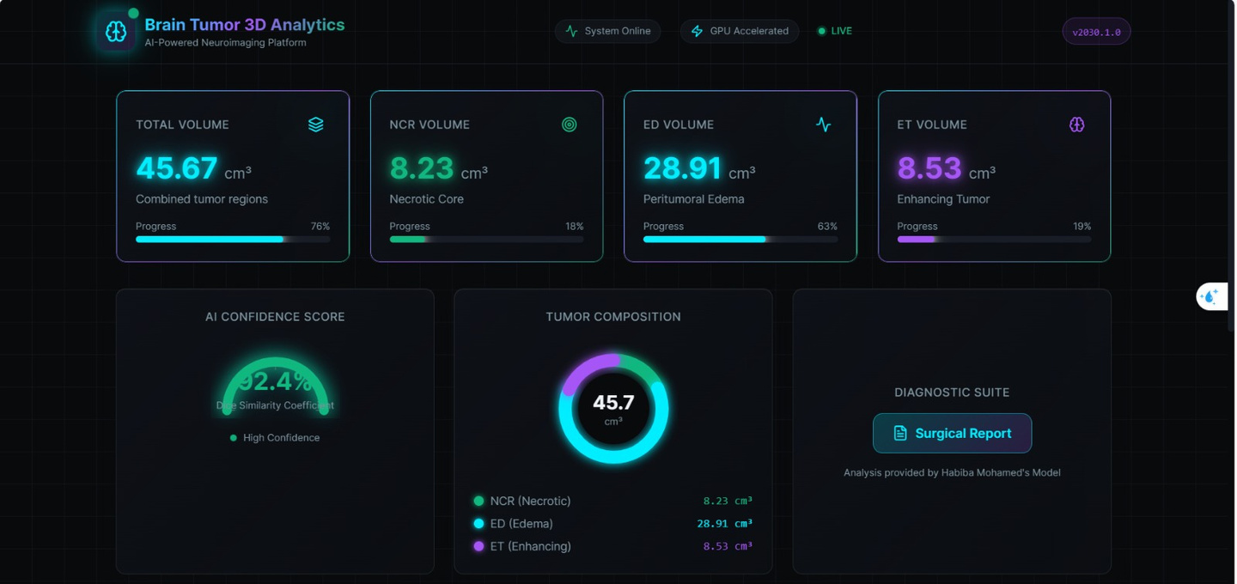
OUR AI SOLUTION
End-to-End Intelligent Neuroimaging Platform
Automatic tumor segmentation
Multi-region analysis
Real-time volume computation
AI confidence scoring
Clinical visualization dashboard
03

Slide 4
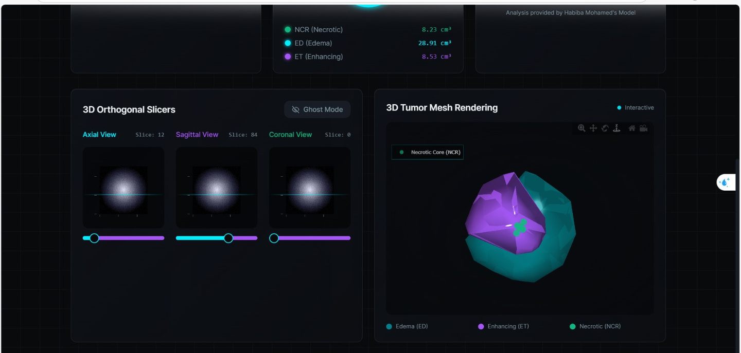
DATASET (BRATS 2021)
DATASET OVERVIEW
MULTI-MODAL MRI:
T2
FLAIR
T1
T1CE
04
TUMOR CLASSES:
NECROTIC CORE
EDEMA
ENHANCING TUMOR

Slide 5


DATA PREPROCESSING
1.
LOAD NIFTI MRI VOLUMES
NORMALIZE EACH MODALITY
2.
05
3.
CROP VOLUMES TO 128×128×128
4.
STACK MODALITIES INTO 4-CHANNEL INPUT

Slide 6
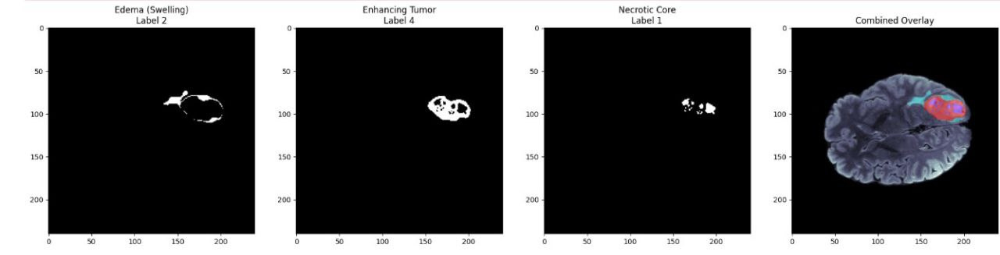
TUMOR SEGMENTATION RESULTS
06
EACH COLOR REPRESENTS A TUMOR REGIO
ACCURATE DETECTION OF TUMOR PARTS
FINAL OVERLAY SHOWS FULL TUMOR ARE

Slide 7
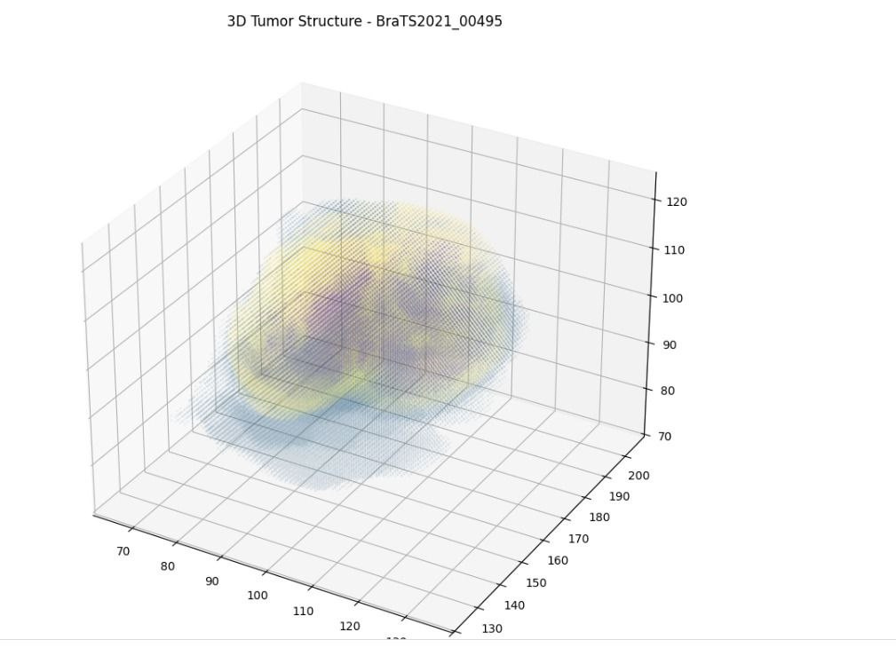
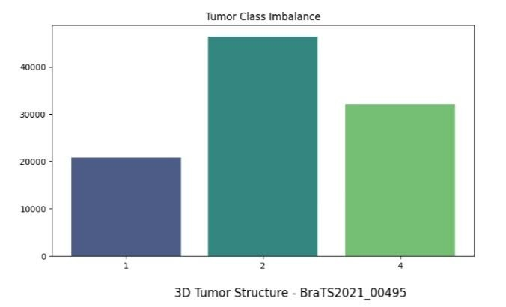
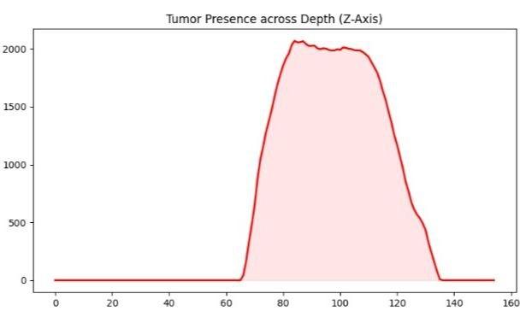
3D TUMOR VISUALIZATION&STRUCTURE
07

Slide 8
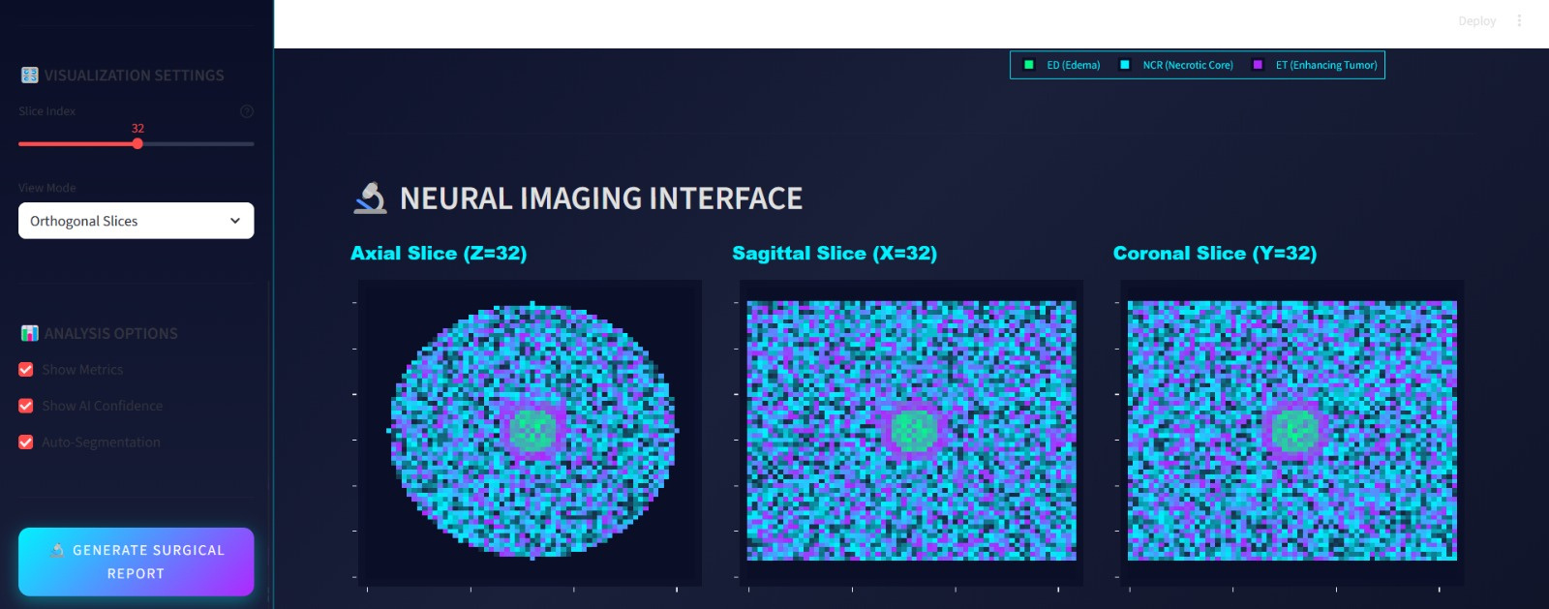
3D TUMOR VISUALIZATION&STRUCTURE
08

Slide 9
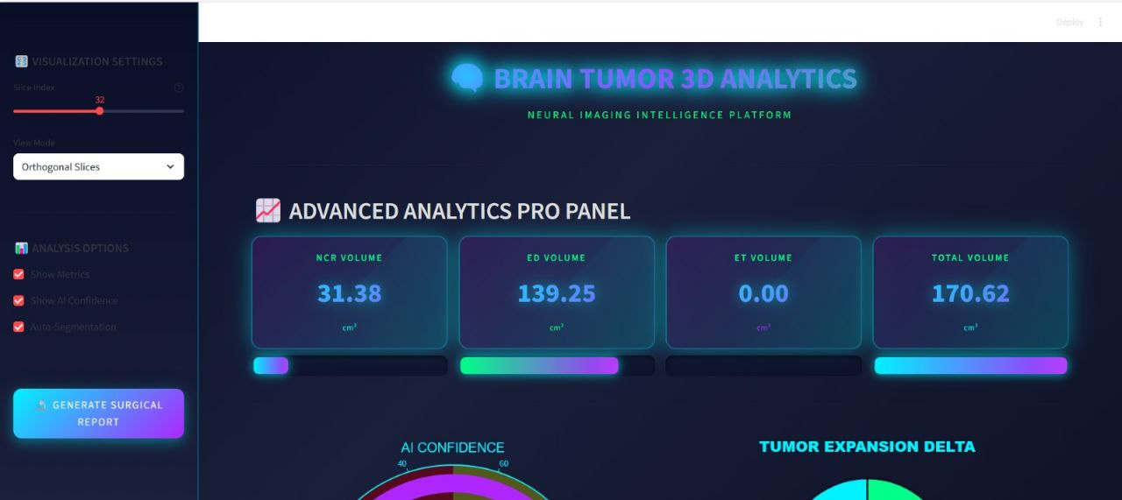
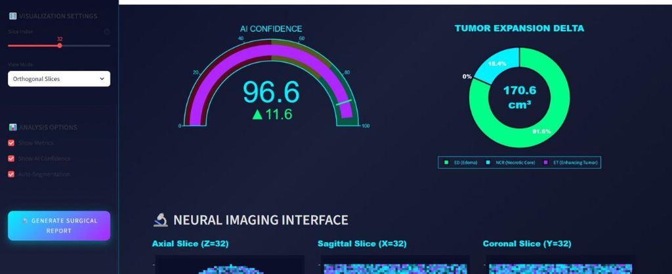
REAL-TIME TUMOR ANALYTICS
09

Slide 10
MODEL ARCHITECTURE
Fully 3D convolutional neural network
Encoder–Decoder structure
Skip connections preserve spatial details
Output: 3 segmentation maps (one per tumor class)
3D U-NET
10

Slide 11
TRAINING CONFIGURATION & STRATEGY
TRAINING SETUP
TRAINING PROCESS
11
FRAMEWORK: PYTORCH
LOSS FUNCTION: BCEWITHLOGITSLOSS
OPTIMIZER: ADAM
LEARNING RATE: 1E-3
BATCH SIZE: 2
EPOCHS: 10
MIXED PRECISION TRAINING (AMP)
TRAINED ON FIRST 300 CASES
STABLE LOSS REDUCTION ACROSS EPOCHS
MODEL CHECKPOINT SAVED AFTER EACH EPOCH

Slide 12
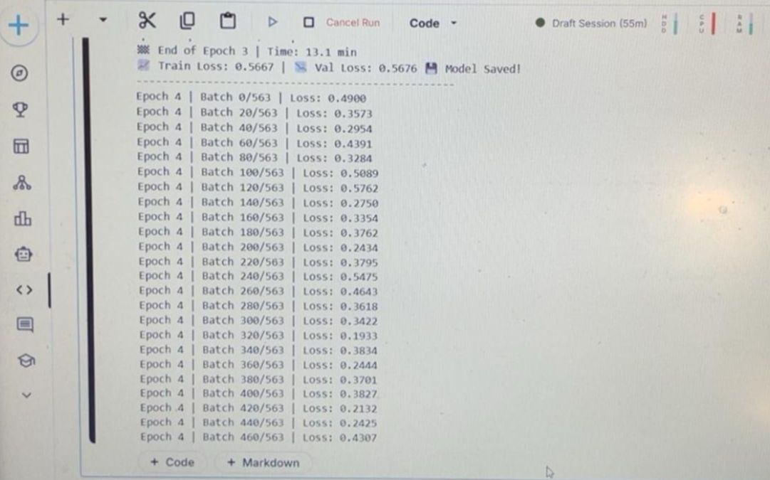
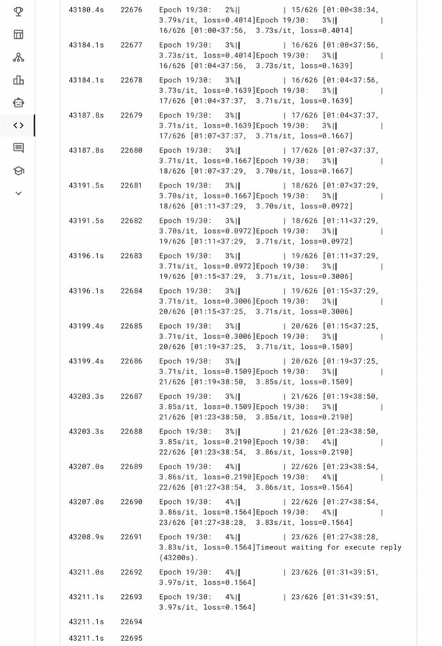
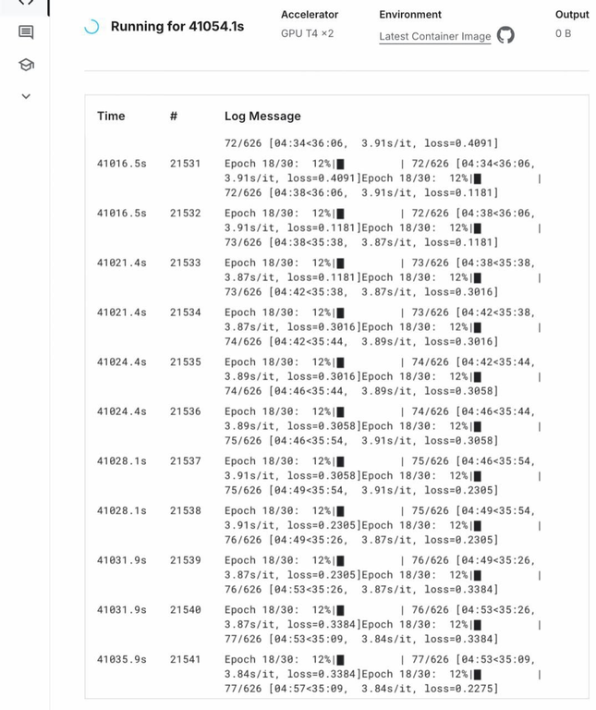
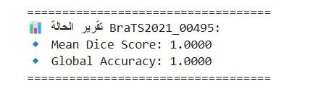
FINAL TRANING
12

Slide 13
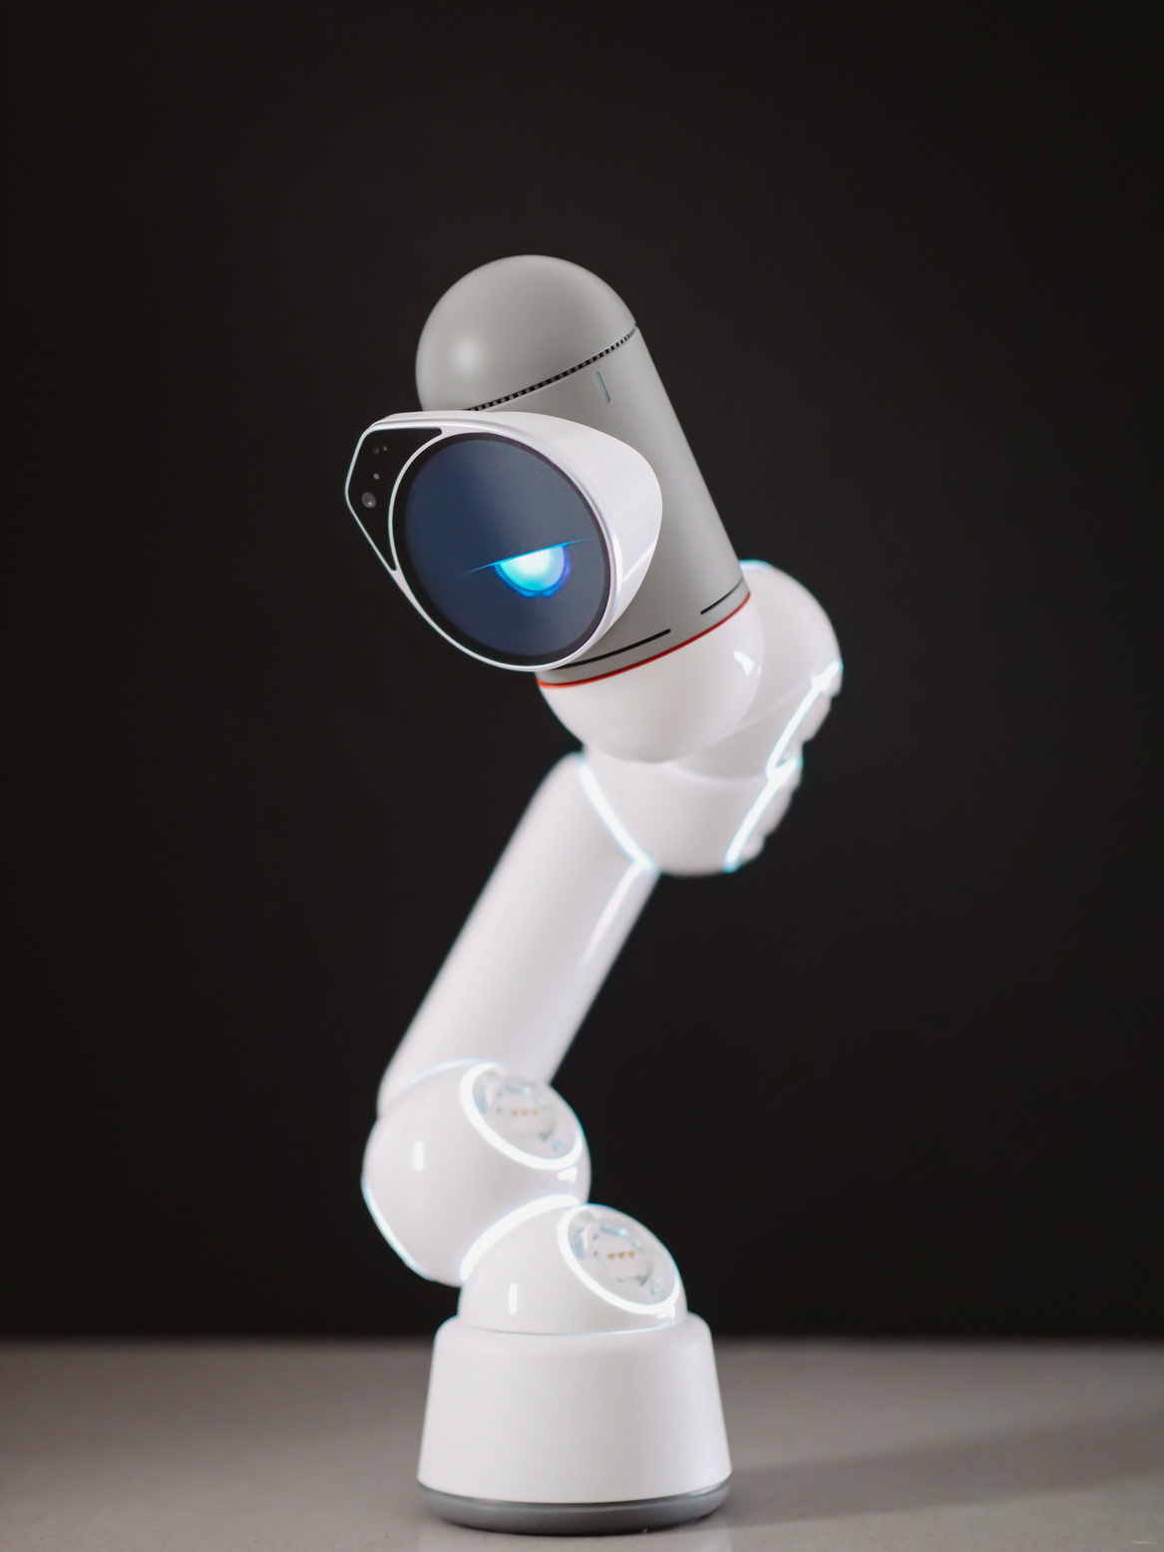
FUTURE WORK
13
1.
Dice / Focal loss
3.
Full BraTS evaluation metrics
4.
Cross-validation
2.
Data augmentation

Slide 14

TEAM
14
1.
Nada Hossam
3.
Habiba Mohamed
2.
Marwan Abdelghaffer
4.
Basel Abdelmaqsoud

Slide 15
THYNK UNLIMITED
THANK
15
YOU.
www.realllygreatsite.com

